Slide 1
QRM Addendum 1

Slide 2
Chebychev
Taking what we started with in class, For Z > 0
E(Z) = Pr(Z ≥ C)*E[Z|Z ≥ C] + Pr(Z < C)*E[Z|Z<C], we know that each of the 4 terms on the right are positive, because all Z’s are positive, and probabilities are all positive. So if we ignore the Pr(Z < C)*E[Z|Z<C] part, we know we are ignoring something positive, so we have.
E(Z) ≥ Pr(Z ≥ C)*E[Z|Z ≥ C];
since E[Z|Z ≥ C] > C, we can write E(Z) ≥ Pr(Z ≥ C)*C
which after rearranging can be written as
Pr(Z ≥ C) ≤ E(Z)/C
Now define (x-μ)² = Z which is always positive and let C = k²σ²,
Note: Pr((x-μ)² > k²σ²) = Pr(|x- μ| > kσ), and E[(x-μ)²] = σ²
Pr(|x- μ| > kσ) ≤ 1 / k²

Slide 3
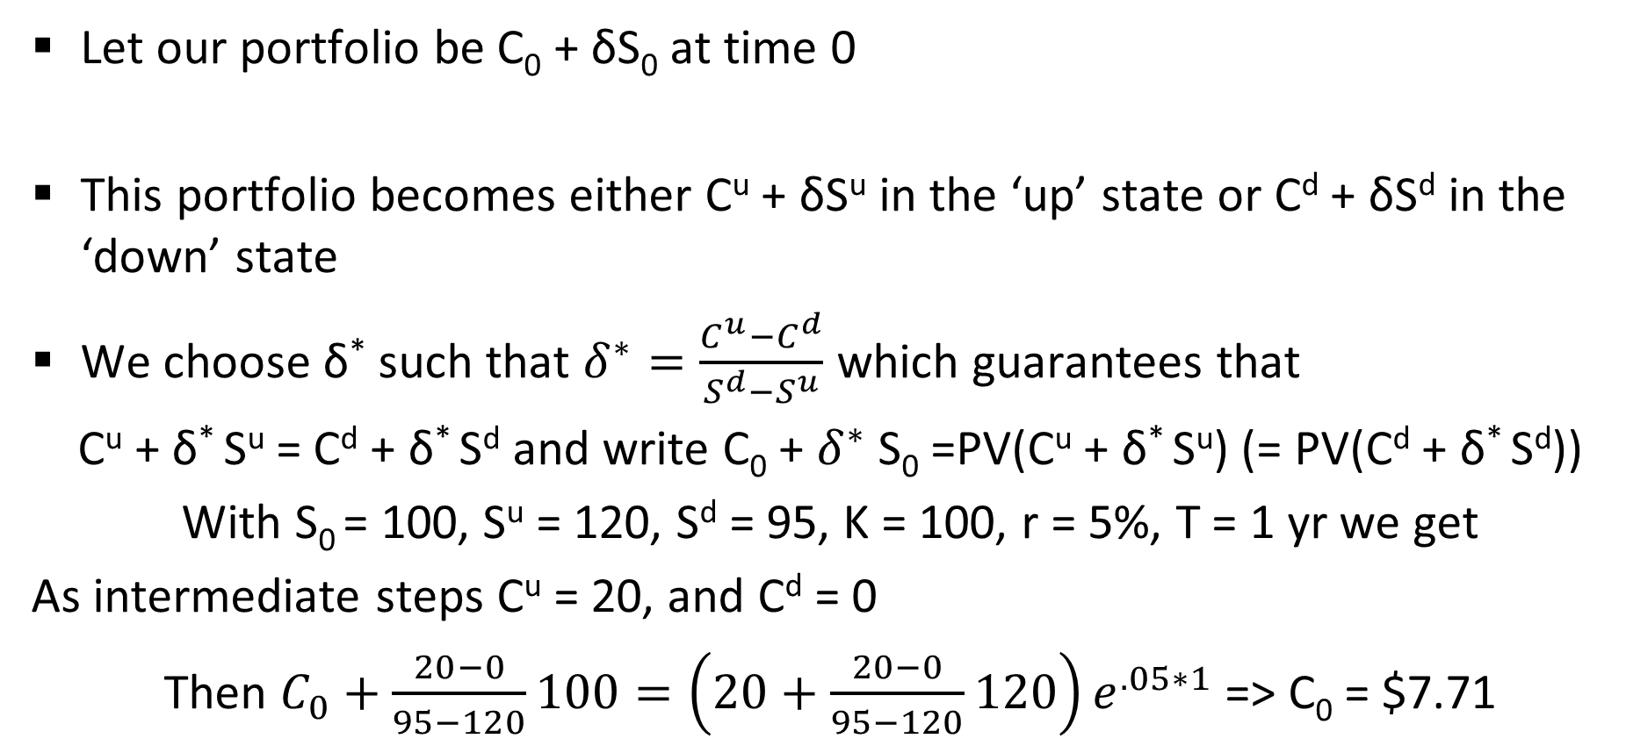
Two-state option pricing
Let our portfolio be C₀ + δS₀ at time 0
This portfolio becomes either C^{u} + δS^{u} in the ‘up’ state or C^{d} + δS^{d} in the ‘down’ state
We choose δ* such that $δ^{∗}=\frac{C^{u}−C^{d}}{S^{d}−S^{u}}$ which guarantees that
C^{u} + δ* S^{u} = C^{d} + δ* S^{d} and write C₀ + $δ^{∗}$S₀ =PV(C^{u} + δ* S^{u}) (= PV(C^{d} + δ* S^{d}))
With S₀ = 100, S^{u} = 120, S^{d} = 95, K = 100, r = 5%, T = 1 yr we get
As intermediate steps C^{u} = 20, and C^{d} = 0
Then $C_{0}+\frac{20−0}{95−120}100={\left(20+\frac{20−0}{95−120}120\right)e}^{.05∗1}$ => C₀ = $7.71

